Slide 1
NEURAL STYLE TRANSFER
Group ID - 14
KHUSHANSH JINDAL(18103119)
KUNAL (18103115)
ASEEM GAUTAM(18103054)

Slide 2
Motivation
In the past, re-drawing an image in a particular style required a well-trained artist
- due to which a lot of time was required
- and it was quite costly for the concerned person
Major step in making A.I. creative ,making it more human like.

Slide 3
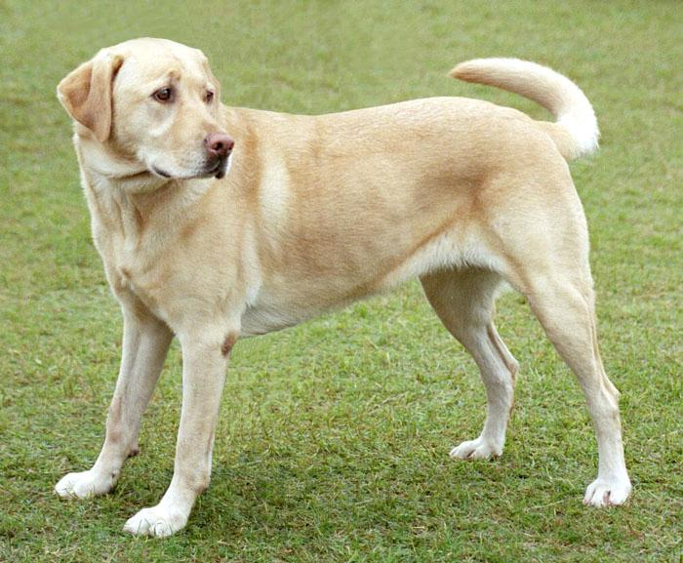
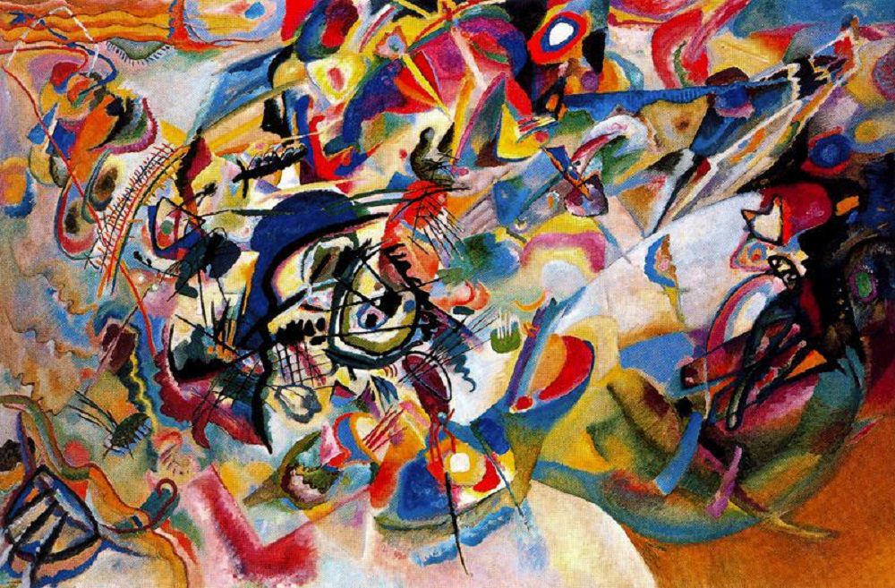
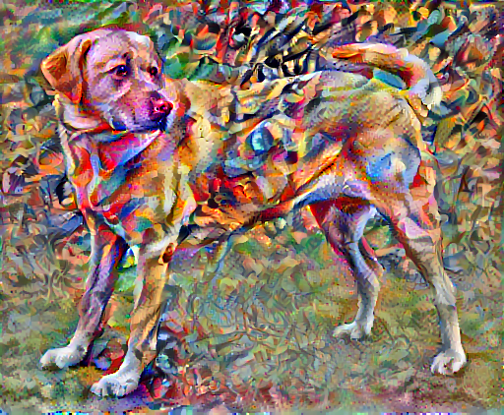
CONTENT IMAGE
STYLE IMAGE
TARGET IMAGE

Slide 4
Features
IN SIMPLER TERMS, WE WANT LAYOUT OF CONTENT IMAGE WITH THE FEATURES OF STYLE IMAGE

Slide 5
TECHNOLOGIES USED
DEEP LEARNING
(AI}
PYTHON
DJANGO
HTML/CSS

Slide 6
Diagrams

Slide 7
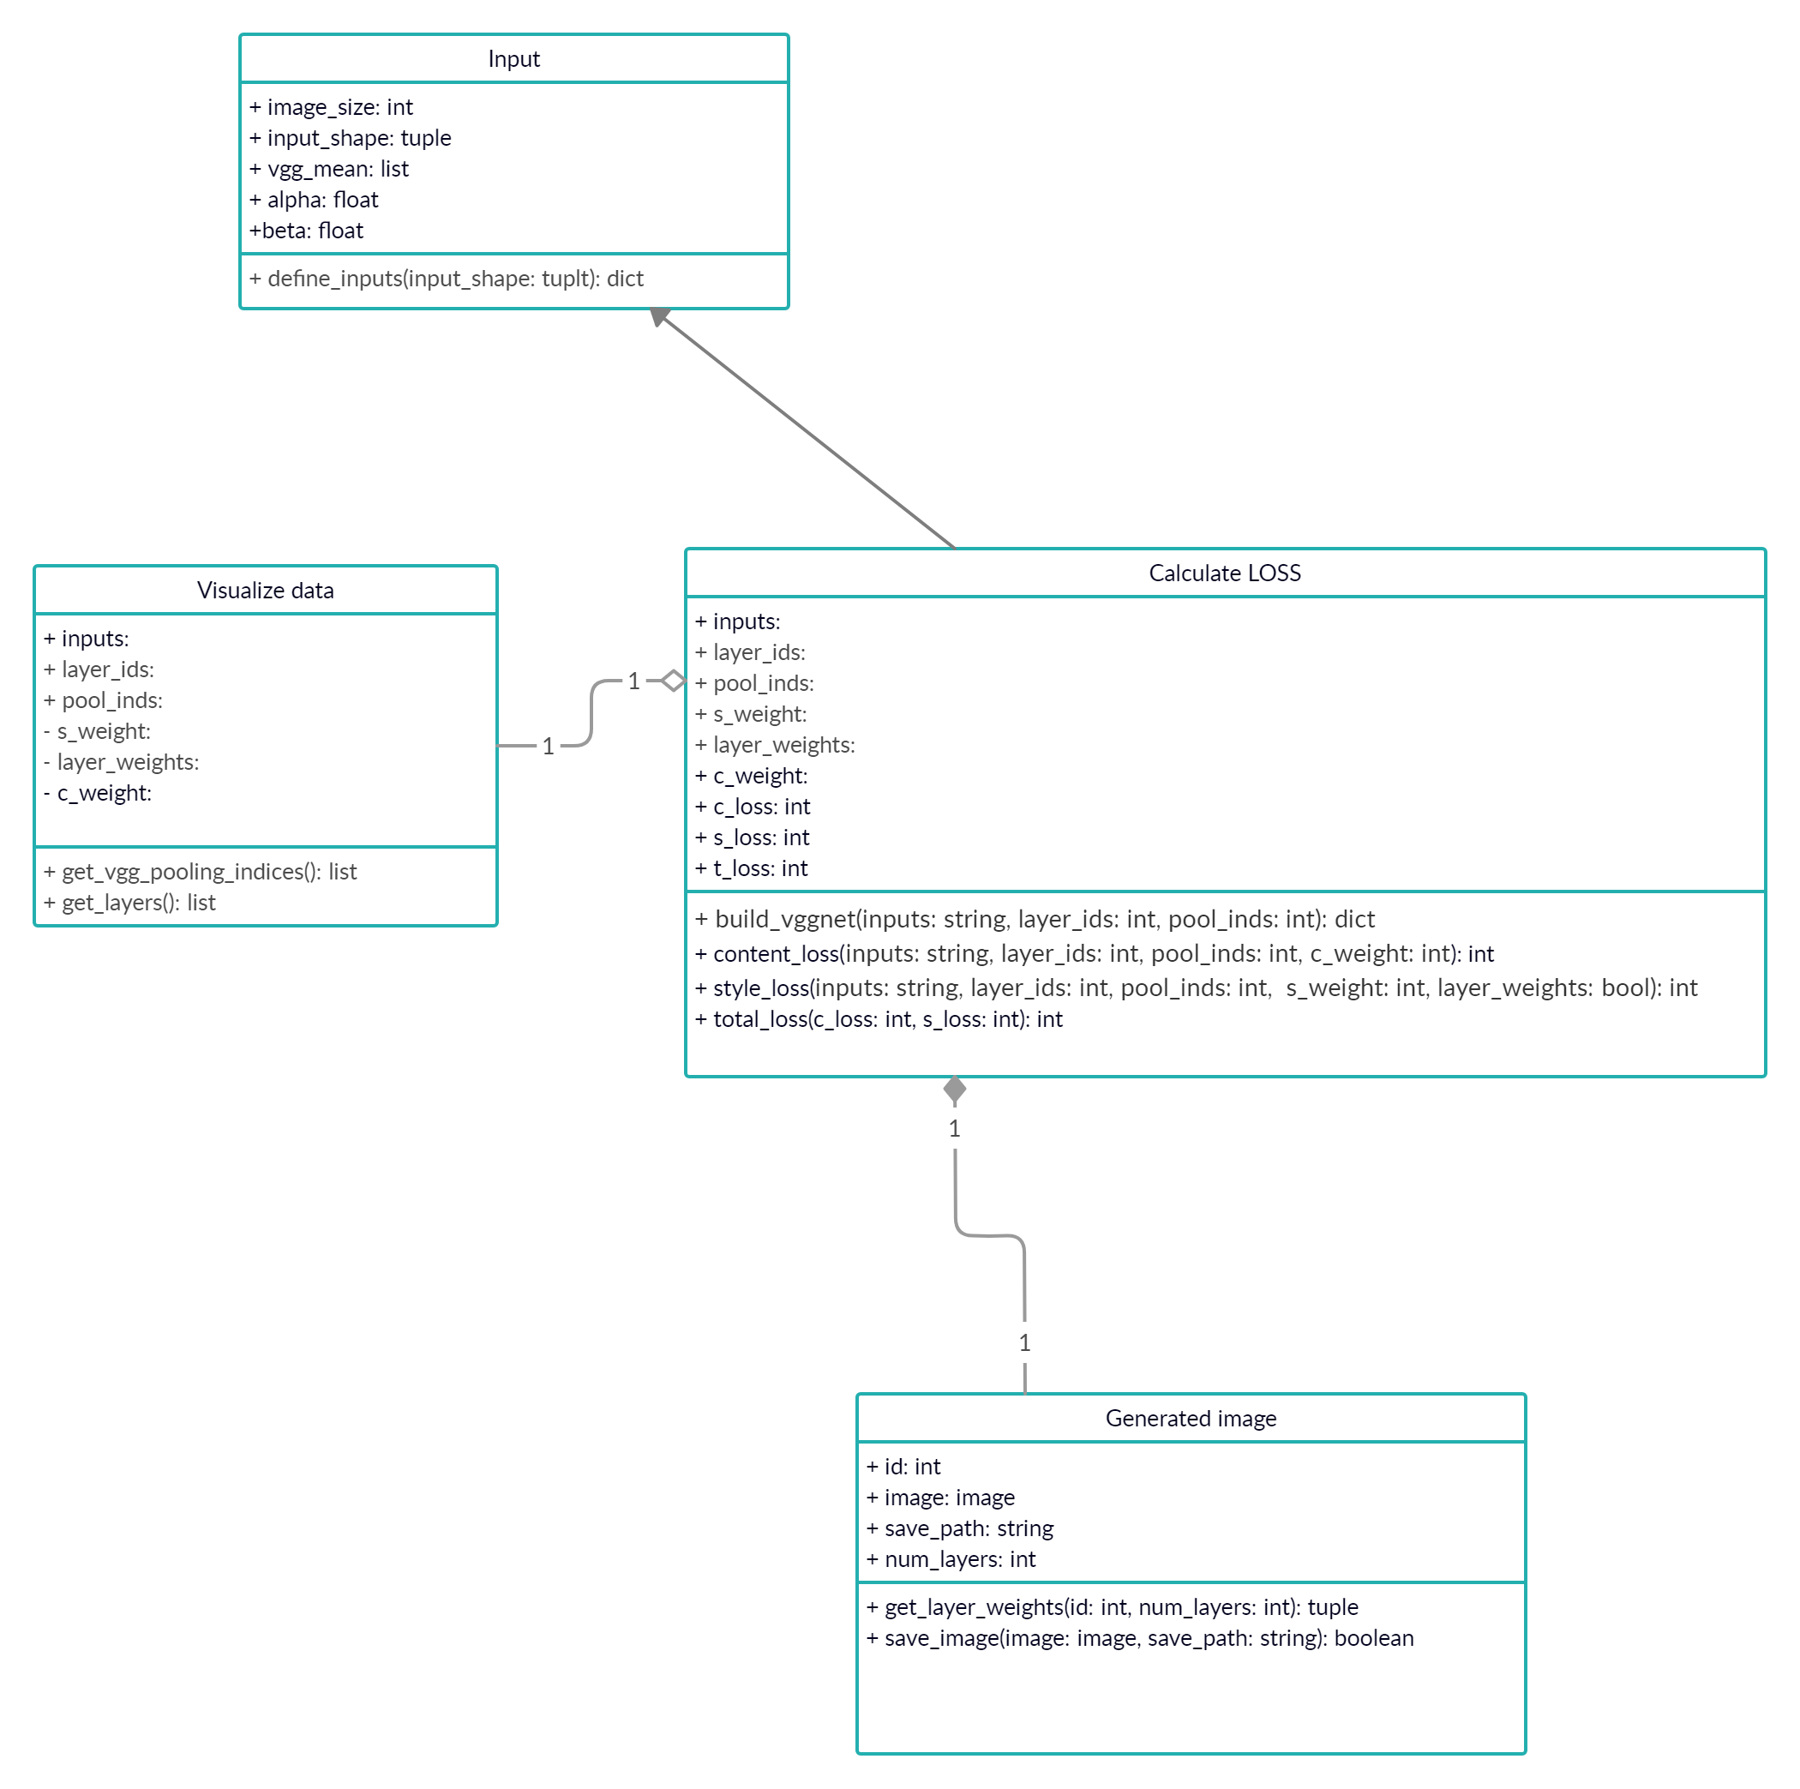
Class Diagram

Slide 8
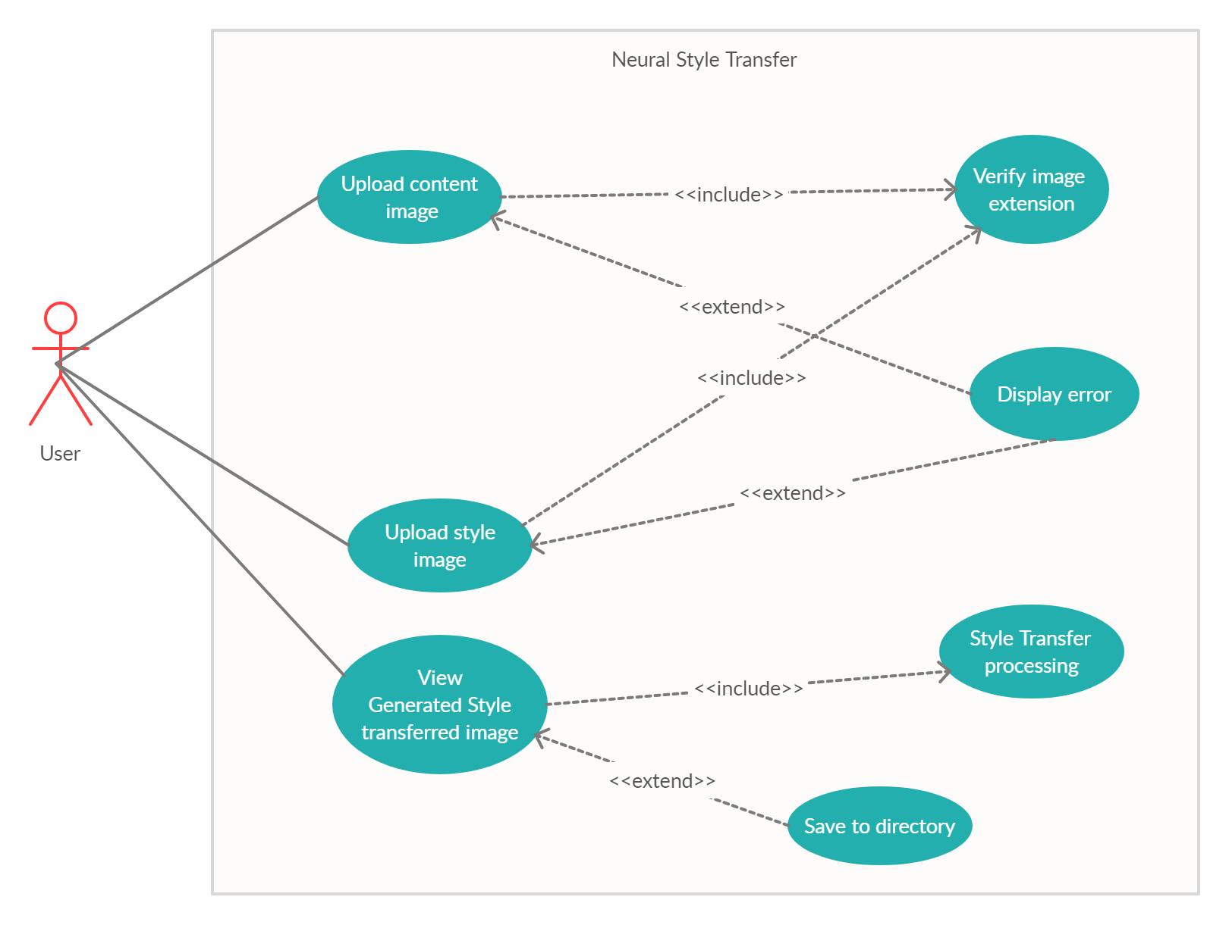
Use Case Diagram

Slide 9
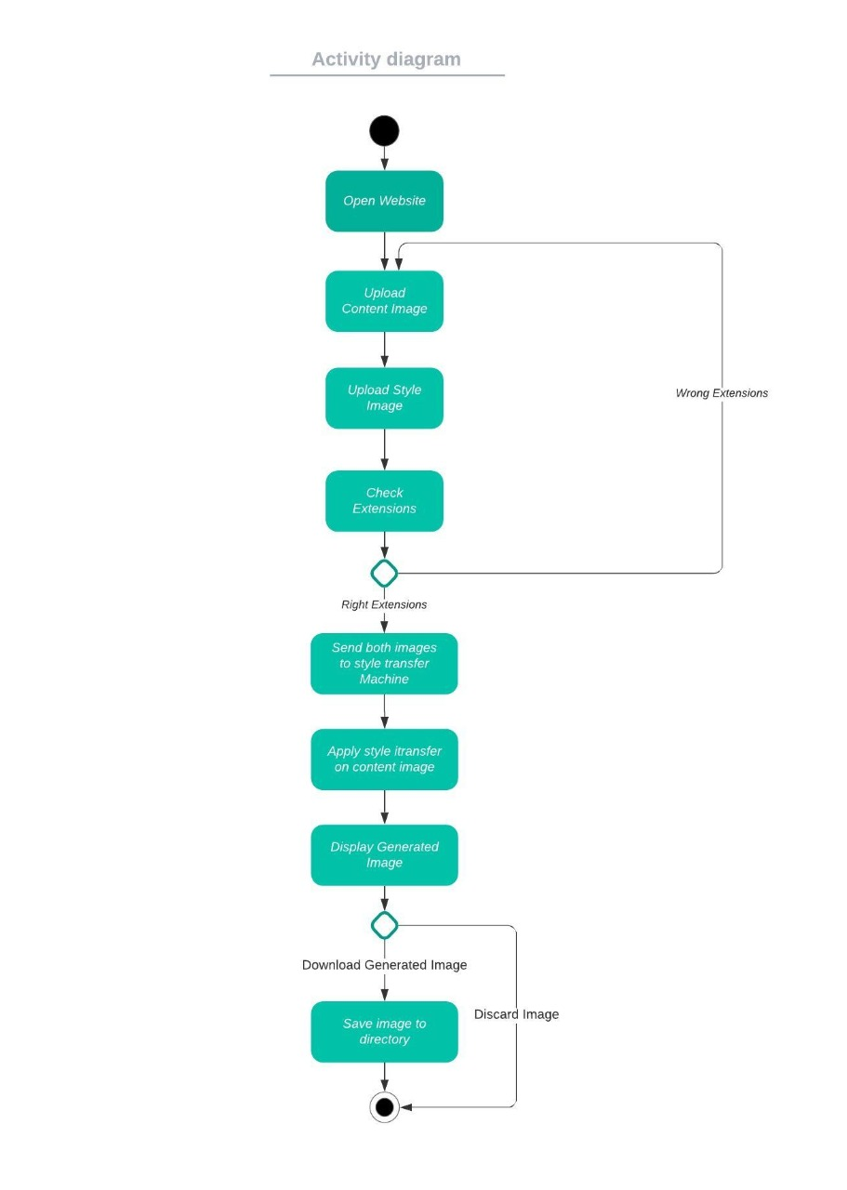
Activity Diagram

Slide 10
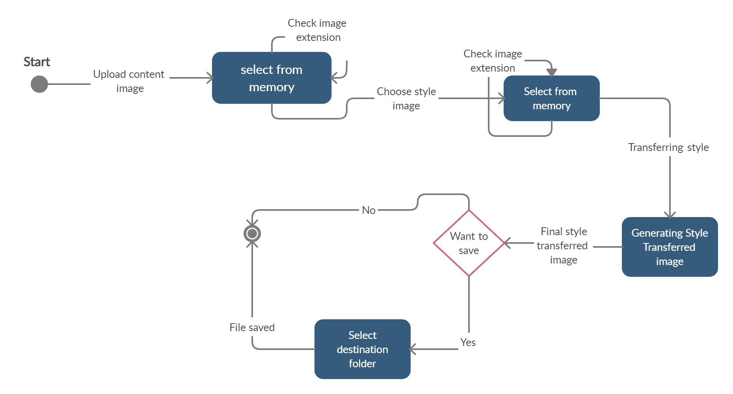
STATE CHART DIAGRAM

Slide 11
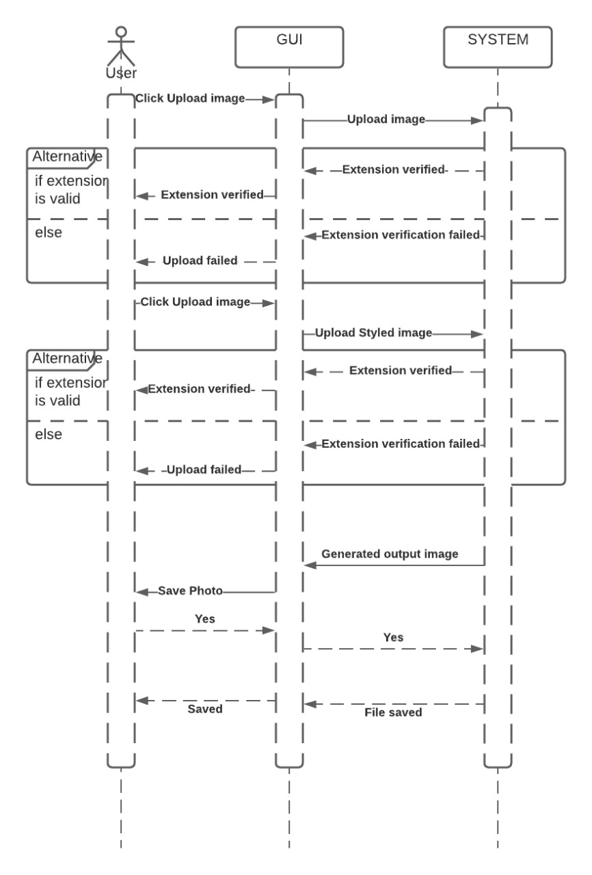
Sequence Diagram

Slide 12
EXECUTION

Slide 13
THANK YOU

